Slide 1

JBoss Server
UPTEAR.ear
Login and Forwarding
Web Application
Authenticate User / Check if User has access to Application
CSM 3.1 Schema
UPT 3.1
Web Application
Provision Auth Policy
Pass Control
CSM 3.2 Schema
UPT 3.2
Web Application
Pass Control
Provision Auth Policy
User attempts Login
UPT 4.0
Web Application
CSM 4.0 Schema
Pass Control
Provision Auth Policy
Pass Control
UPT 4.1
Web Application
CSM 4.1 Schema
Provision Auth Policy
Authenticate User / Check if User has access to Application
LDAP
Authenticate User

Slide 2

Login and Forwarding
Web Application
UPT
Web Application
Pass Control
CSM API
Authenticate
Authorize
Check if User has access
Provision Authorization Policy
Credential Provider
CSM Schema
LDAP
RDBMS

Slide 3
Login and Forwarding Web Application
User authenticated
Check if User has access to Application Context
Populate CSM Login ID and Application Context Name to HTTP Request
Validate User Id and password
Yes
No
User has access
Obtain context of UPT and forward request to UPT web application context
Login Screen for User
No
Yes
UPT Web Application
Redirect to context for Login Web Application
Yes
No
Session is new / Timed out
User ID available in Session
User accesses a UPT page
No
Yes
Allow Access to UPT page

Slide 4
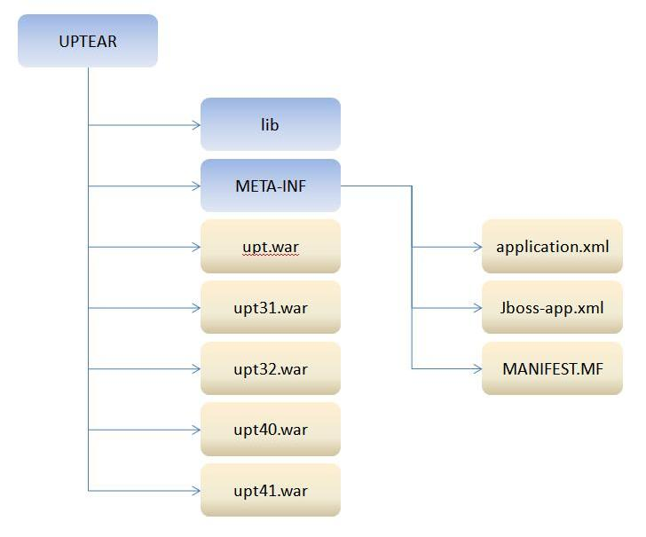
Structure of the UPTEAR

